Slide 1


servicecam.pro
REMOTE EYES FOR PROS
REMOTE VIDEO DIAGNOSTICS FOR FIELD SERVICE
Before you send the truck,
send a camera link.
See the issue live. Guide the customer. Keep the proof in one service record—without an app download.
Create free beta account
Open the no-account demo ↗
Current beta: full Multi-Shop capacity at $0. No card. No automatic conversion.
Source: servicecam.pro · Current offer verified July 15, 2026
01

Slide 2
servicecam.pro
REMOTE EYES FOR PROS
THE OPERATIONAL BLIND SPOT
The first dispatch is too often
the first real look.
01
Descriptions arrive incomplete.
02
Photos live in scattered text threads.
03
The next person inherits the guesswork.
ServiceCam puts a guided first look before the route, then keeps the context after the call.
Source: servicecam.pro/about
02

Slide 3
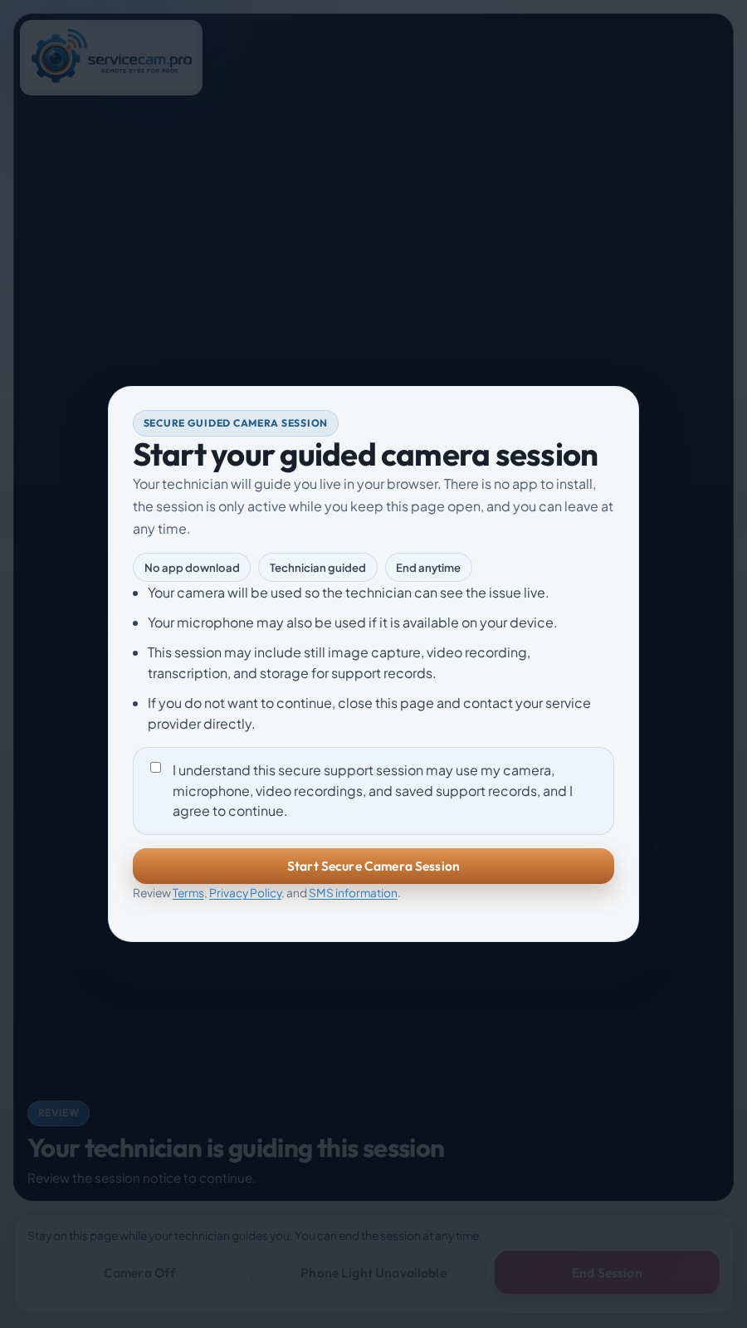
servicecam.pro
REMOTE EYES FOR PROS
THE CUSTOMER EXPERIENCE
One tap.
Phone browser.
No app install.
The customer opens a secure link, reviews the session notice, grants camera access, and follows the technician’s direction.
NO ACCOUNT
Nothing new to create.
CLEAR CONSENT
Purpose and capture notice before entry.
GUIDED LIVE
The technician asks for the angle that matters.
ACTUAL CUSTOMER JOIN SCREEN
Source: servicecam.pro/features/customer-camera-link
03

Slide 4
servicecam.pro
REMOTE EYES FOR PROS
HOMEOWNER / SITE CONTACT
Four simple steps.
No app. No account.
The homeowner uses the phone they already have while the service professional guides the call.
01
02
03
04
Receive the link
Open the browser
Review and allow
Show the issue
It arrives by text or email from the service company.
Tap once. No download, meeting code, or ServiceCam login.
Read the notice, then grant camera and microphone permission.
Point the phone where directed and keep the page open until the call ends.
THE HOMEOWNER NEVER NEEDS A SERVICECAM ACCOUNT.
Source: servicecam.pro/demo · servicecam.pro/features/customer-camera-link
04

Slide 5
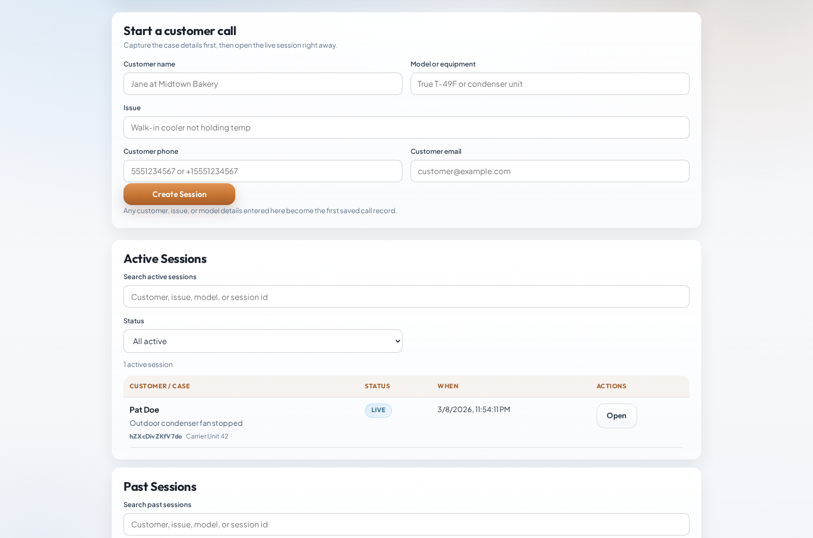
servicecam.pro
REMOTE EYES FOR PROS
THE OPERATOR EXPERIENCE
Every first look starts inside a real ticket.
Capture the customer, equipment, issue, and contact details before the live session opens.
Start from the case—not a detached meeting room.
Send the link by text, email, or copy.
Keep active and past sessions visible.
REAL PRODUCT SCREEN · DASHBOARD INTAKE
Source: servicecam.pro · Actual product screen
05

Slide 6
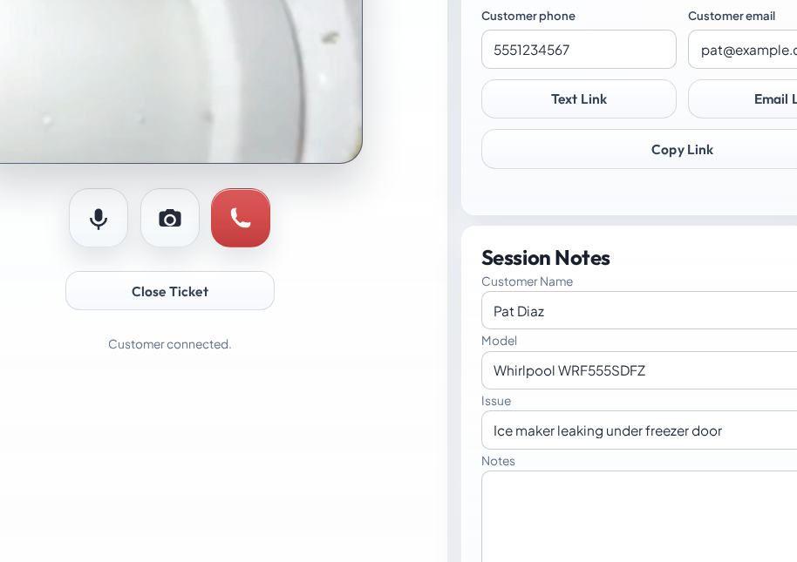
servicecam.pro
REMOTE EYES FOR PROS
DURING THE CALL
Guide the view and document the issue while it is visible.
The live camera, link controls, ticket details, notes, and capture actions stay on one working surface.
GUIDE / CAPTURE / NOTE / CLOSE
REAL PRODUCT SCREEN · LIVE TECHNICIAN WORKSPACE
Source: servicecam.pro/features/remote-video-diagnostics
06

Slide 7
servicecam.pro
REMOTE EYES FOR PROS
SERVICE BUSINESS WORKFLOW
One service record.
From intake to handoff.
01
02
03
04
Open the ticket
Send the link
Guide and document
Decide and hand off
Add the customer, equipment, complaint, and intake notes.
Text it, email it, or copy it into the existing conversation.
Direct the view, save captures, record when needed, and take notes.
Resolve remotely, dispatch with context, or export the record.
PDF SERVICE REPORT • PHOTO ZIP • CALL MP4 • TRANSCRIPT TXT
Source: servicecam.pro/features/reporting-and-export-packets
07

Slide 8
servicecam.pro
REMOTE EYES FOR PROS
DEVICES AND PLATFORMS
Works on the devices people already have.
No native app, browser extension, plug-in, or special camera hardware.
DEVICES
Phones · tablets · laptops · desktops
PLATFORMS
iOS / iPadOS · Android · Windows · macOS · ChromeOS · Linux
RECOMMENDED
Safari on Apple mobile · Chrome on Android / ChromeOS · Chrome, Edge, or Safari for the business workspace
ALSO COMPATIBLE
Firefox and other current WebRTC browsers on a best-effort basis
WHAT IT NEEDS
HTTPS · camera and microphone permission · reliable Wi-Fi or cellular data
Best mobile reliability: open the link in the main browser, not inside Gmail, Outlook, Facebook, or Instagram.
Sources: ServiceCam browser handoff · MDN getUserMedia and WebRTC compatibility
08

Slide 9
servicecam.pro
REMOTE EYES FOR PROS
WHAT CHANGES OPERATIONALLY
Better decisions now.
Better records later.
BEFORE DISPATCH
ON THE ROUTE
AFTER THE CALL
Qualify what the customer can show.
Send a technician with more context.
Start callbacks from a usable record.
See visible conditions, error codes, model details, site access, and installation context.
Give the field team a clearer complaint and the evidence that shaped the next step.
Keep notes, captures, recordings, and exports together for managers and follow-up.
Source: servicecam.pro/about
09

Slide 10
servicecam.pro
REMOTE EYES FOR PROS
BUILT FOR VISIBLE SERVICE QUESTIONS
Use it wherever seeing the issue changes the next step.
01
HVAC
02
Refrigeration
03
Plumbing
04
Electrical
05
Appliance repair
06
General field service
Sources: servicecam.pro/industries/hvac · reefer · plumbing · electrical · appliance-repair
10

Slide 11
servicecam.pro
REMOTE EYES FOR PROS
CURRENT FREE BETA
Start at full capacity for
$0.
10
10
1 TB
USERS
LIVE CALLS
STORAGE
Every beta account receives full Multi-Shop limits. No payment method, no checkout, and no automatic paid conversion.
POST-BETA PLAN
MONTHLY
CAPACITY
STORAGE
Single Truck
$19
1 user · 1 live call
50 GB
Crew
$79
Up to 5 · 5 live calls
250 GB
Multi-Shop
$139
Up to 10 · 10 live calls
1 TB
Pricing verified July 12, 2026. Monthly prices plus applicable taxes; billing begins only if the owner later chooses a paid plan and completes checkout.
Source: servicecam.pro/pricing · Updated July 12, 2026
11

Slide 12
servicecam.pro
REMOTE EYES FOR PROS
THE NEXT STEP
Put ServiceCam on
one real call this week.
Try the browser-to-phone workflow without an account, then open the full beta when your team is ready.
Try the live demo
Create free beta account
Request a setup call ↗
support@servicecam.pro · Powered by MayoFlux
servicecam.pro/contact#setup-call
12

